Slide 1

Unit-1 Computer Data Representation & Register Transfer and Micro-operations
Computer Organization & Architecture (COA)
GTU # 3140707
Prof. Krunal D. Vyas
Computer Engineering Department
krunal.vyas@darshan.ac.in
9601901005

Slide 2

Outline
Basic computer data types & Complements
Fixed point & Floating point representation
Register transfer language
Bus and Memory transfers (Three-State Bus Buffers, Memory Transfer)
Arithmetic Micro-operations
Logic Micro-operations
Shift Micro-operations
Arithmetic logical shift unit
Looping

Slide 3
Basic computer data types & Complements
Section - 1

Slide 4
Basic Computer Data Types & Complements
Basic Computer Data Types
Complements
Decimal Number System
Radix(r) = 10, Number range = 0 - 9
Binary Number System
Radix(r) = 2, Number range = 0 - 1
Octal Number System
Radix(r) = 8, Number range = 0 - 7
Hexadecimal Number System
Radix(r) = 16, Number range = 0 - 9 & A - F
Binary Coded Decimal Numbers
(r-1)’s complement
9’s complement
1’s complement
7’s complement
15’s complement
r’s complement
10’s complement
2’s complement
8’s complement
16’s complement

Slide 5
Fixed point & Floating point representation
Section - 2

Slide 6
Fixed point representation
Integer Representation
Signed-magnitude representation
1’s complement representation
2’s complement representation
Arithmetic Addition
Using 1’s complement
Using 2’s complement
Arithmetic Subtraction
Using 1’s complement
Using 2’s complement
Example: Represent (-14)
Signed-magnitude representation : 1 0001110
1’s complement representation : 1 1110001
2’s complement representation : 1 1110010
+ 6 | 00000110
+ 13 | 00001101
+ 19 | 00010011
+ 6 | 00000110
- 13 | 11110011
- 7 | 11111001
Note: negative number must initially be in 2’s complement

Slide 7
Floating point representation
Two parts
Mantissa – Represents signed fixed-point number
Exponent – Represents position of the decimal point
For example, the decimal number +6132.789 is represented in floating-point with a fraction and an exponent as follows:
The value of the exponent indicates that the actual position of the decimal point is four positions to the right of the indicated decimal point in the fraction.
Floating-point is always interpreted to represent a number in the following form: m X r^{e}
Here, m stands for mantissa, e stands for exponent, r means radix
Fraction
Exponent
+0.6132789
+04

Slide 8
Floating point representation
Normalization
A floating point number is said to be normalized if the most significant digit of the mantissa is nonzero.
For example, the decimal number 350 is normalized but 00035 is not.
ANSI 32-bit floating point byte format
S = Sign of Mantissa, E = Exponent bits, M = Mantissa bits
Example, 13 = 1101 = 0.1101 x 2⁴
= 00000100 .11010000 00000000 00000000
Example, -17 = - 10001 = -0.10001 x 2⁵
= 10000101 .10001000 00000000 00000000
Byte 1
Byte 2
Byte 3
Byte 4
SEEEEEEE
.MMMMMMMM
MMMMMMMM
MMMMMMMM

Slide 9
Register transfer language
Section - 3

Slide 10


Register
Computer Registers are designated by capital letters.
For example,
MAR – Memory Address Register
PC – Program Counter
IR – Instruction Register
R1 – Processor Register
$$R1$$
7 | 6 | 5 | 4 | 3 | 2 | 1 | 0
Register R
Showing individual bits
15
0
15
8
7
0
$$R2$$
PC (H) | PC (L)
Numbering of bits
Divided into two parts

Slide 11

Register Transfer Language
Information transfer from one register to another is designated in symbolic form by means of a replacement operator is known as Register Transfer.
The statement
denotes a transfer of the content of register 𝑅1 into register 𝑅2.
The symbolic notation used to describe the microoperation transfers among registers is called a register transfer language.
The term "register transfer" implies the availability of hardware logic circuits that can perform a stated microoperation and transfer the result of the operation to the same or another register.
A register transfer language is a system for expressing in symbolic form the microoperation sequences among the registers of a digital module.
$$R2←R1$$
R1
1 | 1 | 0 | 1
R2
1 | 1 | 0 | 1

Slide 12

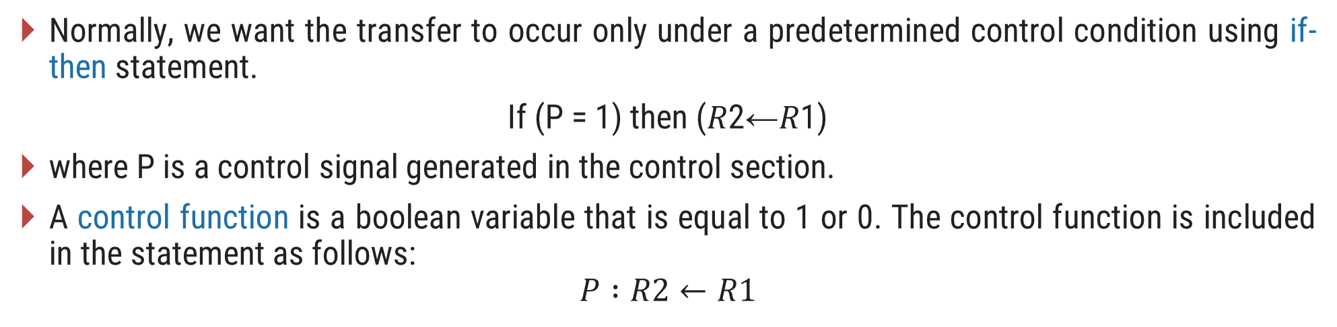

Register Transfer with Control Function
Normally, we want the transfer to occur only under a predetermined control condition using if-then statement.
If (P = 1) then (𝑅2←𝑅1)
where P is a control signal generated in the control section.
A control function is a boolean variable that is equal to 1 or 0. The control function is included in the statement as follows:
$$P :R2←R1$$
t
t+1
P
Load
Clock
Control
circuit
$$R2$$
n
Load
$$R1$$
Transfer occurs here

Slide 13
Bus and Memory transfers
Section - 4

Slide 14
Common Bus System for 4 registers
A typical digital computer has many registers, and paths must be provided to transfer information from one register to another.
The number of wires will be excessive if separate lines are used between each register and all other registers in the system.
A more efficient scheme for transferring information between registers in a multiple-register configuration is a common bus system.
A bus structure consists of a set of common lines, one for each bit of a register, through which binary information is transferred one at a time.
One way of constructing a common bus system is with multiplexers.
The multiplexers select the source register whose binary information is then placed on the bus.
Register A
3 2 1 0
3 2 1 0
3 2 1 0
Register B
Register C

Slide 15
Common Bus System for 4 registers
4-line common bus
0
S₁
S₀
0
A₃
A₂
A₁
A₀
4 x 1
MUX 3
4 x 1
MUX 2
4 x 1
MUX 1
4 x 1
MUX 0
3 2 1 0
3 2 1 0
3 2 1 0
3 2 1 0
D₂
C₂
B₂
A₂
D₁
C₁
B₁
A₁
D₀
C₀
B₀
A₀
D₂
D₁
D₀
C₂
C₁
C₀
B₂
B₁
B₀
A₂
A₁
A₀
3 2 1 0
3 2 1 0
3 2 1 0
3 2 1 0
Register D
Register C
Register B
Register A

Slide 16
Common Bus System for 4 registers
The construction of a bus system for four registers is explained earlier.
Each register has four bits, numbered 0 through 3.
The bus consists of four 4 x 1 multiplexers each having four data inputs, 0 through 3, and two selection inputs, S₁ and S₀.
The diagram shows that the bits in the same significant position in each register are connected to the data inputs of one multiplexer to form one line of the bus.
The two selection lines S₁ and S₀ are connected to the selection inputs of all four multiplexers.
The selection lines choose the four bits of one register and transfer them into the four-line common bus.
When S₁S₀ = 00, the 0 data inputs of all four multiplexers are selected and applied to the outputs that form the bus.
This causes the bus lines to receive the content of register A since the outputs of this register are connected to the 0 data inputs of the multiplexers.

Slide 17
Common Bus System for 4 registers
Table shows the register that is selected by the bus for each of the four possible binary values of the selection lines.
In general, a bus system will multiplex k registers of n bits each to produce an n-line common bus.
The number of multiplexers needed to construct the bus is equal to n, the number of bits in each register.
The size of each multiplexer must be k x 1 since it multiplexes k data lines.
For example, a common bus for eight registers of 16 bits requires
Multiplexers - 16 of (8 x 1)
Select Lines - 3
S₁ | S₀ | Register Selected
0 | 0 | A
0 | 1 | B
1 | 0 | C
1 | 1 | D

Slide 18
Tri-state Buffer (3 state Buffer)
A three-state gate is a digital circuit that exhibits three states.
Two of the states are signals equivalent to logic 1 and 0 as in a conventional gate.
The third state is high impedance state which behaves like an open circuit, which means that the output is disconnected and does not have logic significance.
The control input determines the output state. When the control input C is equal to 1, the output is enabled and the gate behaves like any conventional buffer, with the output equal to the normal input.
When the control input C is 0, the output is disabled and the gate goes to a high-impedance state, regardless of the value in the normal input.
Normal Input A
Output Y = A if C =1
High-impedance if C = 0
Control Input C

Slide 19
Common Bus System using Decoder and Tri-state Buffer
Bus line for bit 0
A₀
B₀
C₀
C₀
D₀
2 x 4
Decoder
1
0
1
2
3
S₁
S₀
E
Select
0
1
Enable

Slide 20
Common Bus System using Decoder and Tri-state Buffer
The construction of a bus system with three-state buffers is demonstrated in previous figure.
The outputs of four buffers are connected together to form a single bus line.
The control inputs to the buffers determine which of the four normal inputs will communicate with the bus line.
The connected buffers must be controlled so that only one three-state buffer has access to the bus line while all other buffers are maintained in a high impedance state.
One way to ensure that no more than one control input is active at any given time is to use a decoder, as shown in the figure: Bus line with three state-buffers.
When the enable input of the decoder is 0, all of its four outputs are 0, and the bus line is in a high-impedance state because all four buffers are disabled.
When the enable input is active, one of the three-state buffers will be active, depending on the binary value in the select inputs of the decoder.

Slide 21
Arithmetic Micro-operations
Section - 5

Slide 22
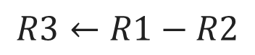
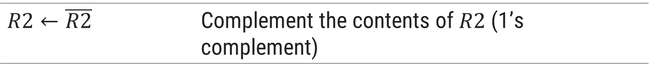
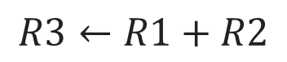
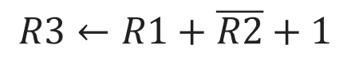
Arithmetic Microoperations
Arithmetic microoperations perform arithmetic operations on numeric data stored in registers.
Symbolic Designation | Description
Add Microoperation
$$R3←R1+R2$$ | Contents of $R1$ plus $R2$ transferred to $R3$
$$R3←R1+R2$$
$$R3←R1−R2$$ | Contents of $R1$ minus $R2$ transferred to $R3$
$$R2←\overline{R2}$$ | Complement the contents of $R2$ (1’s complement)
Subtract Microoperation
$$R2←\overline{R2}+1$$ | 2’s complement the contents of $R2$ (negate)
$$R3←R1−R2$$
$$R3←R1+\overline{R2}+1$$ | $R1$ plus the 2’s complement of $R2$ (subtraction)
$$R3←R1+\overline{R2}+1$$
$$R1←R1+1$$ | Increment the content of $R1$ by one
$$R1←R1−1$$ | Decrement the content of $R1$ by one

Slide 23
4-bit Binary Adder
The digital circuit that generates the arithmetic sum of two binary numbers of any length is called a binary adder.
Example
0
1
1
1
1
0
1
1
B₃
A₃
B₂
A₂
B₁
A₁
B₀
A₀
1
1
1
0
C
1
1
1
0
FA
C₃
FA
C₂
FA
C₁
FA
C₀
R1
1
1
0
1
A
R2
+
0
1
1
1
B
Sum
1
0
1
0
0
C₄
S₃
S₂
S₁
S₀
1
0
1
0
0

Slide 24
The binary adder is constructed with full-adder circuits connected in cascade, with the output carry from one full-adder connected to the input carry of the next full-adder.
The figure shows the interconnections of four full-adders (FA) to provide a 4-bit binary adder.
The augends bits of A and the addend bits of B are designated by subscript numbers from right to left, with subscript 0 denoting the low-order bit.
The carries are connected in a chain through the full-adders.
The input carry to the binary adder is C0 and the output carry is C4.
The S outputs of the full-adders generate the required sum bits.
An n-bit binary adder requires n full-adders.
The output carry from each full-adder is connected to the input carry of the next-high-order full-adder.
The n data bits for the A inputs come from one register (such as R1), and the n data bits for the B inputs come from another register (such as R2). The sum can be transferred to a third register or to one of the source registers (R1 or R2), replacing its previous content.

Slide 25
4-bit Binary Adder-Subtractor
when M = 0 the circuit is an Adder
when M = 1 the circuit becomes a Subtractor
When M = 0, we have
C₀ = 0 & B ⊕ 0 = B
When M = 1, we have
C₀ = 1 & B ⊕ 1 = B’
B₃
A₃
B₂
A₂
B₁
A₁
B₀
A₀
1
0
1
0
1
0
1
0
1
0
M
B₃’
B₃
B₂’
B₂
B₁’
B₁
B₀’
B₀
FA
C₃
FA
C₂
FA
C₁
FA
C₀
C₄
S₃
S₂
S₁
S₀

Slide 26
4-bit Binary Incrementer
The increment microoperation adds one to a number in a register.
1
1
0
1
A₃
A₂
A₁
A₀
1
0
0
1
x
y
x
y
x
y
x
y
C
0
0
1
R1
1
1
0
1
HA
HA
HA
HA
+
1
Sum
1
1
1
0
C
S
C
S
C
S
C
S
C₄
S₃
S₂
S₁
S₀
0
1
1
1
0

Slide 27
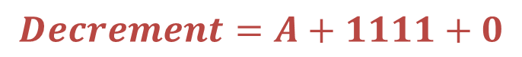
4-bit Arithmetic Circuit
The arithmetic micro operations can be implemented in one composite arithmetic circuit.
The basic component of an arithmetic circuit is the parallel adder.
By controlling the data inputs to the adder, it is possible to obtain different types of arithmetic operations.
The output of binary adder is calculated from arithmetic sum.
𝑫=𝑨+𝒀+𝑪_{𝒊𝒏}
Decrement using 2’s complement
1
1
1
1
1
0
1
1
1
0
1
-
1
2’s complement
+
1
1
1
1
$$Decrement=A+1111+0$$
1
1
0
0
1
1
1
0
0
Discard carry

Slide 28
4-bit Arithmetic Circuit
Decremented content of A
D₀
D₁
D₂
D₃
C_{out}
0
C₀
C₁
C₁
C₂
C₂
C₃
C₃
C₄
FA
FA
FA
FA
X₀
Y₀
X₁
Y₁
X₂
Y₂
X₃
Y₃
1
1
1
1
4 x 1
MUX
4 x 1
MUX
4 x 1
MUX
4 x 1
MUX
S₁ S₀ 0 1 2 3
S₁ S₀ 0 1 2 3
S₁ S₀ 0 1 2 3
S₁ S₀ 0 1 2 3
1
0
0
C_{in}
A₀
B₀
A₁
B₁
A₂
B₂
A₃
B₃
S₁
S₀
1
1

Slide 29
4-bit Arithmetic Circuit
Hardware implementation consists of:
4 full-adder circuits that constitute the 4-bit adder and four multiplexers for choosing different operations.
There are two 4-bit inputs A and B.
The four inputs from A go directly to the X inputs of the binary adder. Each of the four inputs from B is connected to the data inputs of the multiplexers. The multiplexer’s data inputs also receive the complement of B.
The other two data inputs are connected to logic-0 and logic-1.
Logic-0 is a fixed voltage value (0 volts for TTL integrated circuits)
Logic-1 signal can be generated through an inverter whose input is 0.
The four multiplexers are controlled by two selection inputs, S₁ and S₀.
The input carry C_{in} goes to the carry input of the FA in the least significant position. The other carries are connected from one stage to the next.
4-bit output D₀…D₃

Slide 30
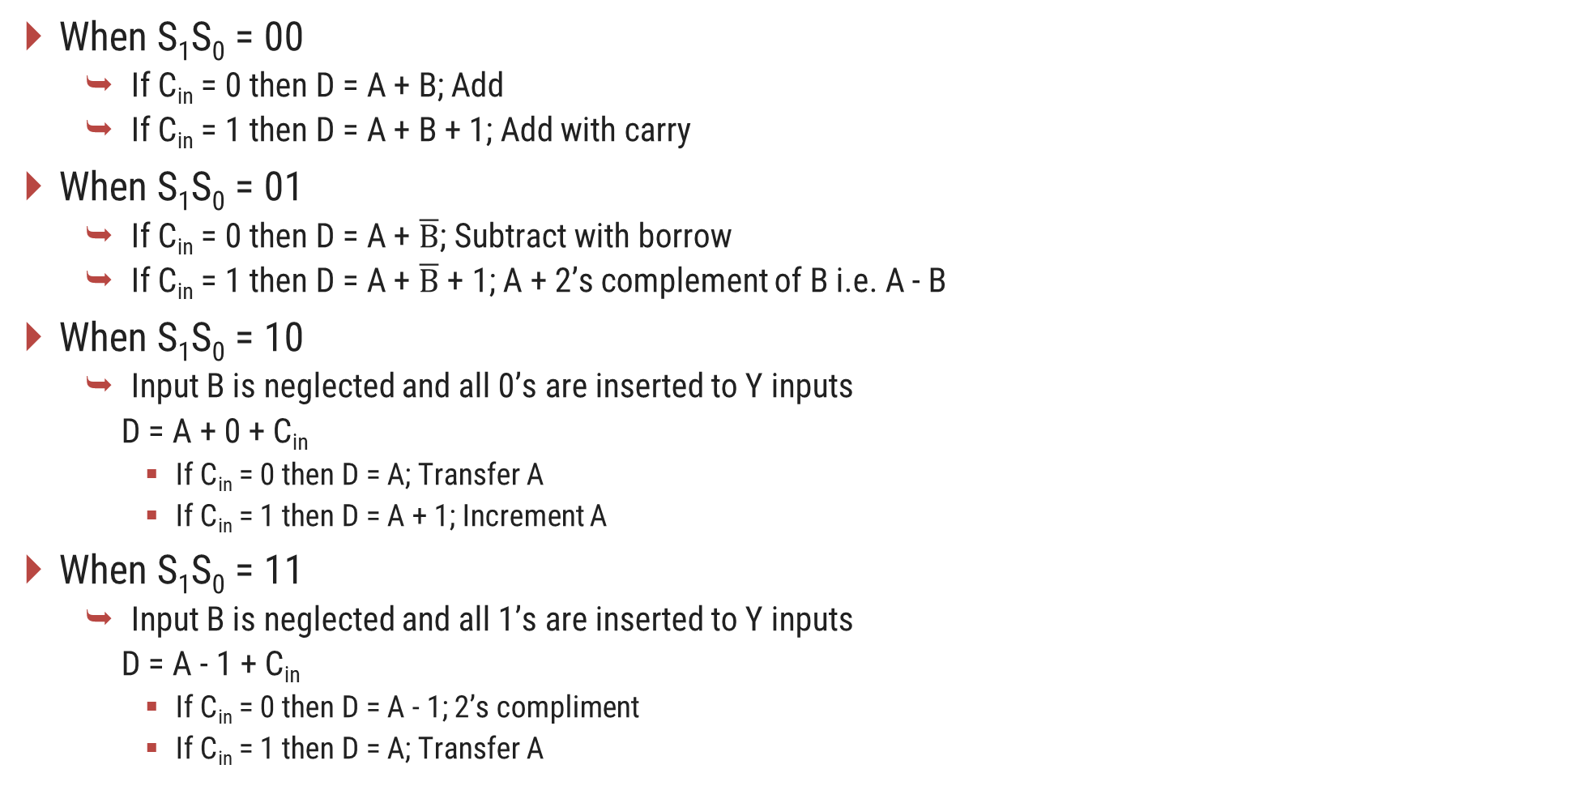
4-bit Arithmetic Circuit
When S₁S₀ = 00
If C_{in} = 0 then D = A + B; Add
If C_{in} = 1 then D = A + B + 1; Add with carry
When S₁S₀ = 01
If C_{in} = 0 then D = A + $\overline{B}$; Subtract with borrow
If C_{in} = 1 then D = A + $\overline{B}$ + 1; A + 2’s complement of B i.e. A - B
When S₁S₀ = 10
Input B is neglected and all 0’s are inserted to Y inputs
D = A + 0 + C_{in}
If C_{in} = 0 then D = A; Transfer A
If C_{in} = 1 then D = A + 1; Increment A
When S₁S₀ = 11
Input B is neglected and all 1’s are inserted to Y inputs
D = A - 1 + C_{in}
If C_{in} = 0 then D = A - 1; 2’s compliment
If C_{in} = 1 then D = A; Transfer A

Slide 31
4-bit Arithmetic Circuit
Arithmetic Circuit Function
S₁ | S₀ | C_{in} | Y | D = A + Y + C_{in} | Microoperation
0 | 0 | 0 | B | D = A + B | Add
0 | 0 | 1 | B | D = A + B + 1 | Add with carry
0 | 1 | 0 | B’ | D = A + B’ | Subtract with borrow
0 | 1 | 1 | B’ | D = A + B’ + 1 | Subtract
1 | 0 | 0 | 0 | D = A | Transfer
1 | 0 | 1 | 0 | D = A + 1 | Increment A
1 | 1 | 0 | 1 | D = A – 1 | Decrement A
1 | 1 | 1 | 1 | D = A | Transfer A

Slide 32
Logic Micro-operations
Section - 6

Slide 33


Logic Microoperations
Logic micro operations specify binary operations for strings of bits stored in registers.
These operations consider each bit of the register separately and treat them as binary variables.
Example
$$P: R1←R1 ⨁ R2$$
R1
1
0
1
0
R2
$$⨁$$
1
1
0
0
R1 after P = 1
0
1
1
0

Slide 34
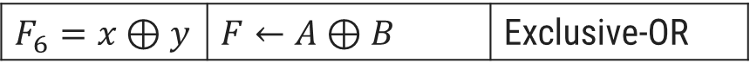
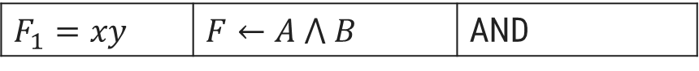
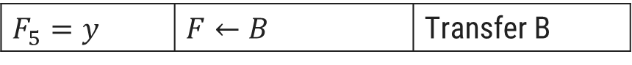
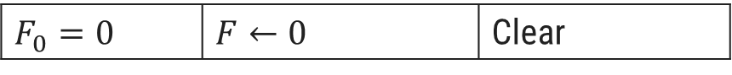
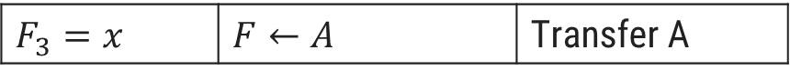
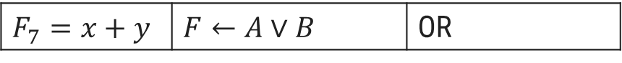
Logic Microoperations
Boolean Function | Microoperation | Name
Boolean Function | Microoperation | Name
$$F_{8}=(x+y)′$$ | $$F←\overline{A∨B}$$ | NOR
$$F_{0}=0$$ | $$F←0$$ | Clear
$$F_{9}=(x⊕y)′$$ | $$F←\overline{A⊕B}$$ | Exclusive-NOR
$$F_{1}=xy$$ | $$F←A ⋀ B$$ | AND
$$F_{10}=y′$$ | $$F←\overline{B}$$ | Complement B
$$F_{2}=xy′$$ | $$F←A ⋀ \overline{B}$$
$$F_{3}=x$$ | $$F←A$$ | Transfer A
$$F_{11}=x+y′$$ | $$F←A∨\overline{B}$$
$$F_{4}=x′y$$ | $$F←\overline{A} ⋀ B$$
$$F_{12}=x′$$ | $$F←\overline{A}$$ | Complement A
$$F_{5}=y$$ | $$F←B$$ | Transfer B
$$F_{13}=x′+y$$ | $$F←\overline{A}∨B$$
$$F_{6}=x⊕y$$ | $$F←A⊕B$$ | Exclusive-OR
$$F_{14}=(xy)′$$ | $$F←\overline{A∧B}$$ | NAND
$$F_{7}=x+y$$ | $$F←A∨B$$ | OR
$$F_{15}=1$$ | $$F←all 1^{′}s$$ | Set to all 1’s

Slide 35
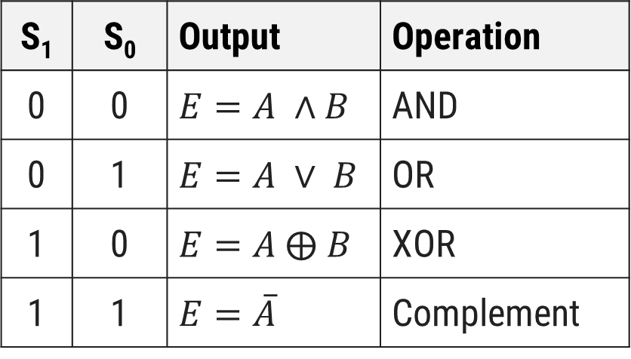
Hardware Implementation of Logic Circuit
S₁
4 x 1
MUX
S₀
S₁ | S₀ | Output | Operation
0 | 0 | $$E=A ∧B$$ | AND
0 | 1 | $$E=A ∨ B$$ | OR
1 | 0 | $$E=A ⨁ B$$ | XOR
1 | 1 | $$E=\overline{A}$$ | Complement
A_{i}
B_{i}
0
1
2
3
E_{i}

Slide 36
Applications of Logic Microoperations
Selective Set Operation
The selective-set operation sets to 1 the bits in register A where there are corresponding 1's in register B.
It does not affect bit positions that have 0's in B.
The OR microoperation can be used to selectively set bits of a register.
1
0
1
0
A before
1
1
0
0
B (logic operand)
1
1
1
0
A after

Slide 37
Applications of Logic Microoperations
Selective Complement Operation
The selective-complement operation complements bits in register A where there are corresponding 1's in register B.
It does not affect bit positions that have 0's in B.
The exclusive - OR microoperation can be used to selectively set bits of a register.
1
0
1
0
A before
1
1
0
0
B (logic operand)
0
1
1
0
A after

Slide 38
Applications of Logic Microoperations
Selective Clear Operation
The selective-clear operation clears to 0 the bits in register A only where there are corresponding 1's in register B.
It does not affect bit positions that have 0's in B.
The corresponding logic microoperation is A ← A ∧ B’.
1
0
1
0
A before
1
1
0
0
B (logic operand)
0
0
1
0
A after

Slide 39
Applications of Logic Microoperations
Mask Operation
The mask operation is similar to the selective-clear operation except that the bits of register A are cleared only where there are corresponding 0’s in register B.
The mask operation is an AND microoperation.
1
0
1
0
A before
1
1
0
0
B (logic operand)
1
0
0
0
A after

Slide 40
Applications of Logic Microoperations
Insert Operation
The insert operation inserts a new value into a group of bits.
This is done by first masking and then ORing them with required value.
The mask operation is an AND microoperation and the insert operation is an OR microoperation.
Mask
Insert
A
0
1
1
0
1
0
1
0
A
0
0
0
0
1
0
1
0
B
0
0
0
0
1
1
1
1
B
1
0
0
1
0
0
0
0
A
0
0
0
0
1
0
1
0
A
1
0
0
1
1
0
1
0

Slide 41
Applications of Logic Microoperations
Clear Operation
The clear operation compares the words in register A and register B and produces an all 0’s result if the two numbers are equal.
This operation is achieved by an exclusive-OR microoperation.
1
0
1
0
A
1
0
1
0
B
0
0
0
0
A ← A ⊕ B

Slide 42
Shift Micro-operations
Section - 7

Slide 43
Shift Microoperations
Shift microoperations are used for serial transfer of data.
Used in conjunction with arithmetic, logic and other data processing operations.
The content of the register can be shifted to the left or the right.
The first flip-flop receives its binary information from the serial input.
The information transferred through the serial input determines the type of shift.
Types of Shift
Logical
Circular
Arithmetic

Slide 44
Types of Shift
Logical Shift
A logical shift is one that transfers 0 through the serial input.
shl - logical shift left
shr - logical shift right
R1
1 | 1 | 0 | 1
R1
1 | 1 | 0 | 1
R1
1
0
1
0
R1
0
1
1
0

Slide 45
Types of Shift
Circular Shift
A circular shift (also known as a rotate operation) circulates the bits of the register around the two ends without loss of information.
This is accomplished by connecting the serial output of the shift register to its serial input.
cil - circular shift left
cir - circular shift right
R1
1 | 1 | 0 | 1
R1
1 | 1 | 0 | 1
R1
1
0
1
1
R1
1
1
1
0

Slide 46
Types of Shift
Arithmetic Shift
An arithmetic shift is a micro-operation that shifts a signed binary number to the left or right.
An arithmetic shift-left multiplies a signed binary number by 2.
An arithmetic shift-right divides the number by 2.
ashl - arithmetic shift left
ashr - arithmetic shift right
R1
1 | 1 | 0 | 1
R1
1 | 1 | 0 | 1
R1
1
0
1
0
R1
1
1
1
0

Slide 47
4 - bit Combinational Circuit Shifter
Select
0 – Shift right
1 – Shift left
0
S
0
1
0
H₀
I_{R}
MUX
1
A₀
S | H₀ | H₁ | H₂ | H₃
0 | I_{R} | A₀ | A₁ | A₂
1 | A₁ | A₂ | A₃ | I_{L}
1
A₁
S
0
1
1
H₁
0
MUX
A₂
1
A₃
S
0
1
1
H₂
MUX
S
0
1
0
H₃
MUX
I_{L}

Slide 48
4 - bit Combinational Circuit Shifter
The 4-bit shifter has four data inputs, A₀ through A₃ and four data outputs, H₀ through H₃.
There are two serial inputs, one for shift left (I_{L}) and the other for shift right (I_{L}).
When the selection input S = 0, the input data are shifted right (down in the diagram).
When S = 1, the input data are shifted left (up in the diagram).
The two serial inputs can be controlled by another multiplexer to provide the three possible types of shifts.

Slide 49
Arithmetic logical shift unit
Section - 8

Slide 50
4 - bit Arithmetic Logic Shift Unit
Instead of having individual registers performing the micro operations directly, computer systems employ a number of storage registers connected to a common operational unit called an arithmetic logic unit, abbreviated ALU.
To perform a microoperation, the contents of specified registers are placed in the inputs of the common ALU.
The ALU performs an operation and the result of the operation is then transferred to a destination register.
The arithmetic, logic, and shift circuits introduced in previous sections can be combined into one ALU with common selection variables.

Slide 51
4 - bit Arithmetic Logic Shift Unit
S₃
S₂
S₁
C_{i}
S₀
One stage of arithmetic circuit
D_{i}
0
1
2
3
Select
4 x 1
MUX
F_{i}
C_{i} +1
One stage of logic circuit
E_{i}
B_{i}
A_{i}
A_{i-1}
shr
A_{i+1}
shl

Slide 52
4 - bit Arithmetic Logic Shift Unit
S₃ | S₂ | S₁ | S₀ | C_{in} | Operation | Function
S₃ | S₂ | S₁ | S₀ | C_{in} | Operation | Function
0 | 0 | 0 | 0 | 0 | F = A | Transfer A
0 | 0 | 1 | 1 | 1 | F = A | Transfer A
0 | 0 | 0 | 0 | 1 | F = A + 1 | Increment A
0 | 1 | 0 | 0 | x | F = $A ⋀ B$ | AND
0 | 0 | 0 | 1 | 0 | F = A + B | Addition
0 | 1 | 0 | 1 | x | F = $A∨B$ | OR
0 | 0 | 0 | 1 | 1 | F = A + B + 1 | Add with carry
0 | 1 | 1 | 0 | x | F = A ⊕B | XOR
0 | 0 | 1 | 0 | 0 | F = A + B’ | Subtract with borrow
0 | 1 | 1 | 1 | x | F = A’ | Complement A
1 | 0 | x | x | x | F = shr A | Shift right A into F
0 | 0 | 1 | 0 | 1 | F = A + B’ + 1 | Subtraction
1 | 1 | x | x | x | F = shl A | Shift left A into F
0 | 0 | 1 | 1 | 0 | F = A – 1 | Decrement

Slide 53
Questions asked in GTU exam
What do you mean by register transfer? Explain in detail. Also discuss three-state bus buffer.
List and explain types of shift operations on accumulator.
Define RTL. Explain how register transfer takes place in basic computer system
What is multiplexing? Explain the multiplexing of control signals in ALU.
Explain how complement number system is useful in computer system. Discuss any one complement number system with example.
Draw the block diagram of 4-bit arithmetic circuit and explain it in detail.
Explain shift micro operations and Draw neat and clean diagram for 4-bit combinational circuit shifter.
Explain hardware implementation of common bus system using three state buffers. Mention assumptions if required.
Explain 4-bit adder-subtractor with diagram.
Explain floating point representation.
What is a Digital Computer System? Explain the role of binary number system in it.
Design a digital circuit for 4-bit binary adder.

Slide 54
Questions asked in GTU exam
Represent (8620)₁₀ in (1) binary (2) Excess-3 code and (3) 2421 code.
Explain selective set, selective complement and selective clear.
How negative integer number represented in memory? Explain with suitable example.
Explain Micro operation.
What does this mean: R2 ← R1?
What does this mean: T0: R4 ← R0?
What is a Bus?
What is an ALU?
Represent the following conditional control statement(s) by two register transfer statements with control function. If (P=1) then (R1 ← R2) else if (Q=1) then (R1 ← R3)
State true or false: In binary number system, B - A is equivalent to B + A' + 1.
Draw a diagram of 4-bit binary incrementer and explain it briefly.

